Slide 1
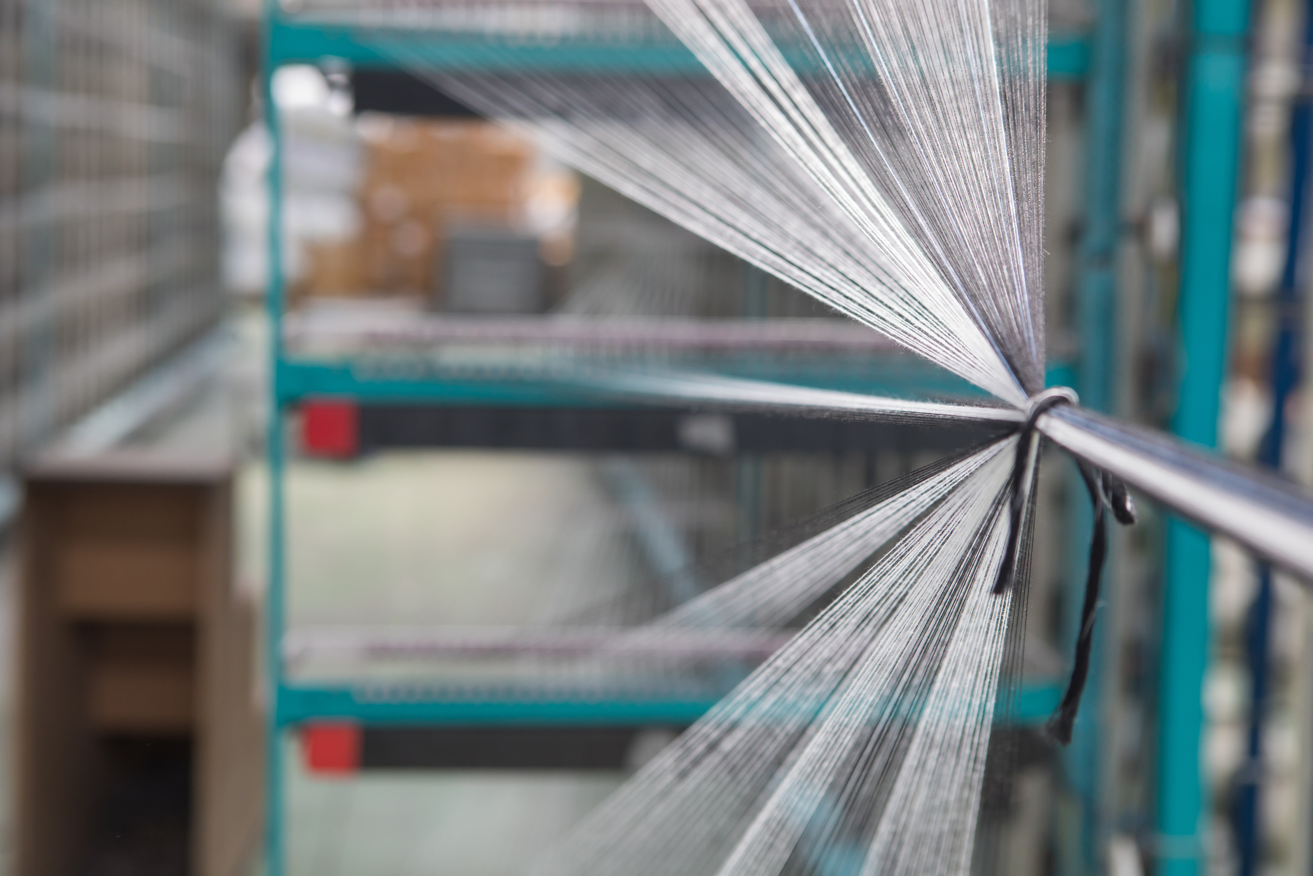

USPAR TEKSTIL COMPANY PROFILE
2021
DENIZLI - TURKEY

Slide 2
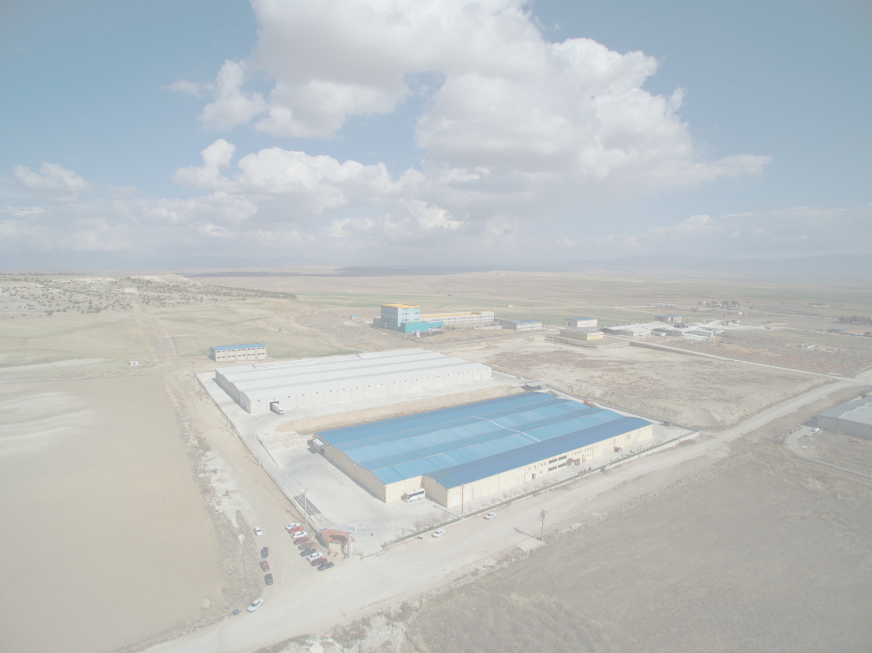
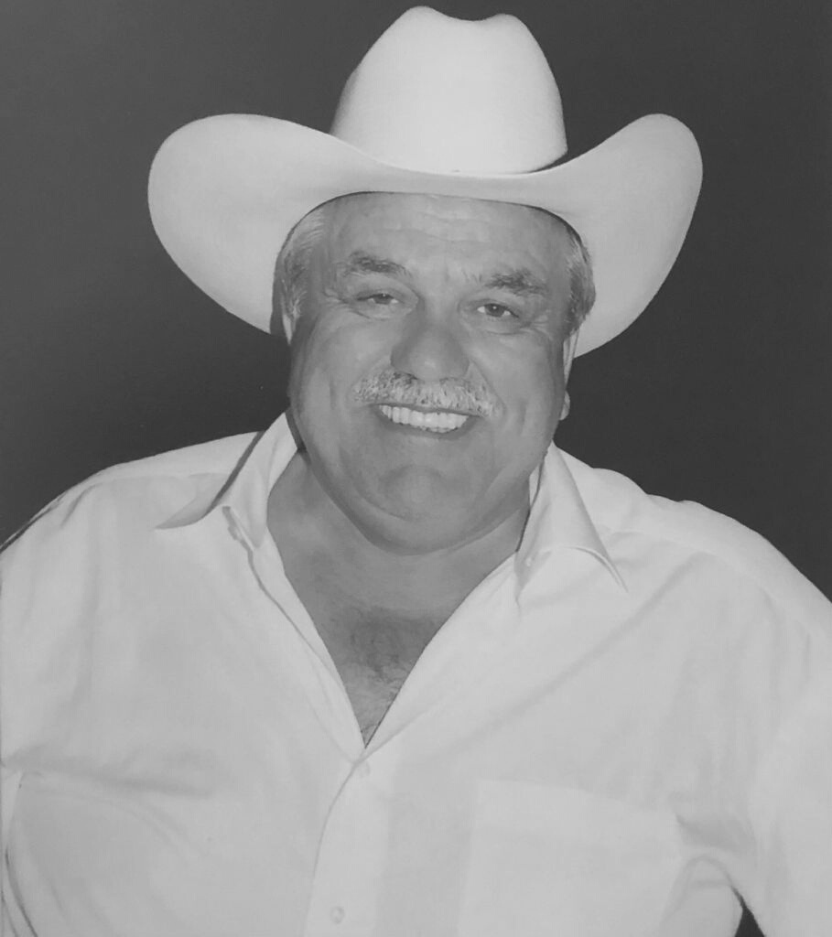

BRIEF HISTORY
The origins of the USPAR TEKSTIL SANAYI VE TICARET A.S. dates back to 1970’s, during which its late founder, Mr. Ismail USLU ,father of Ahmet and Fevzi USLU, was trying to earn his own living as a yarn and raw fabric trader in Istanbul.
1985 Mr. USLU founded USLU TEKSTIL Inc.
1986 Mr.USLU kept on his attempts by opening the first Open-End plant in DENIZLI Organized Industrial Zone.
1994 Second Open-End plant was started manufacturing to keep up the changing market conditions. 1997 Ismail USLU and Enver PARALI families combined their strength with the name “USPAR Tekstil Inc.” and became partners.

Slide 3
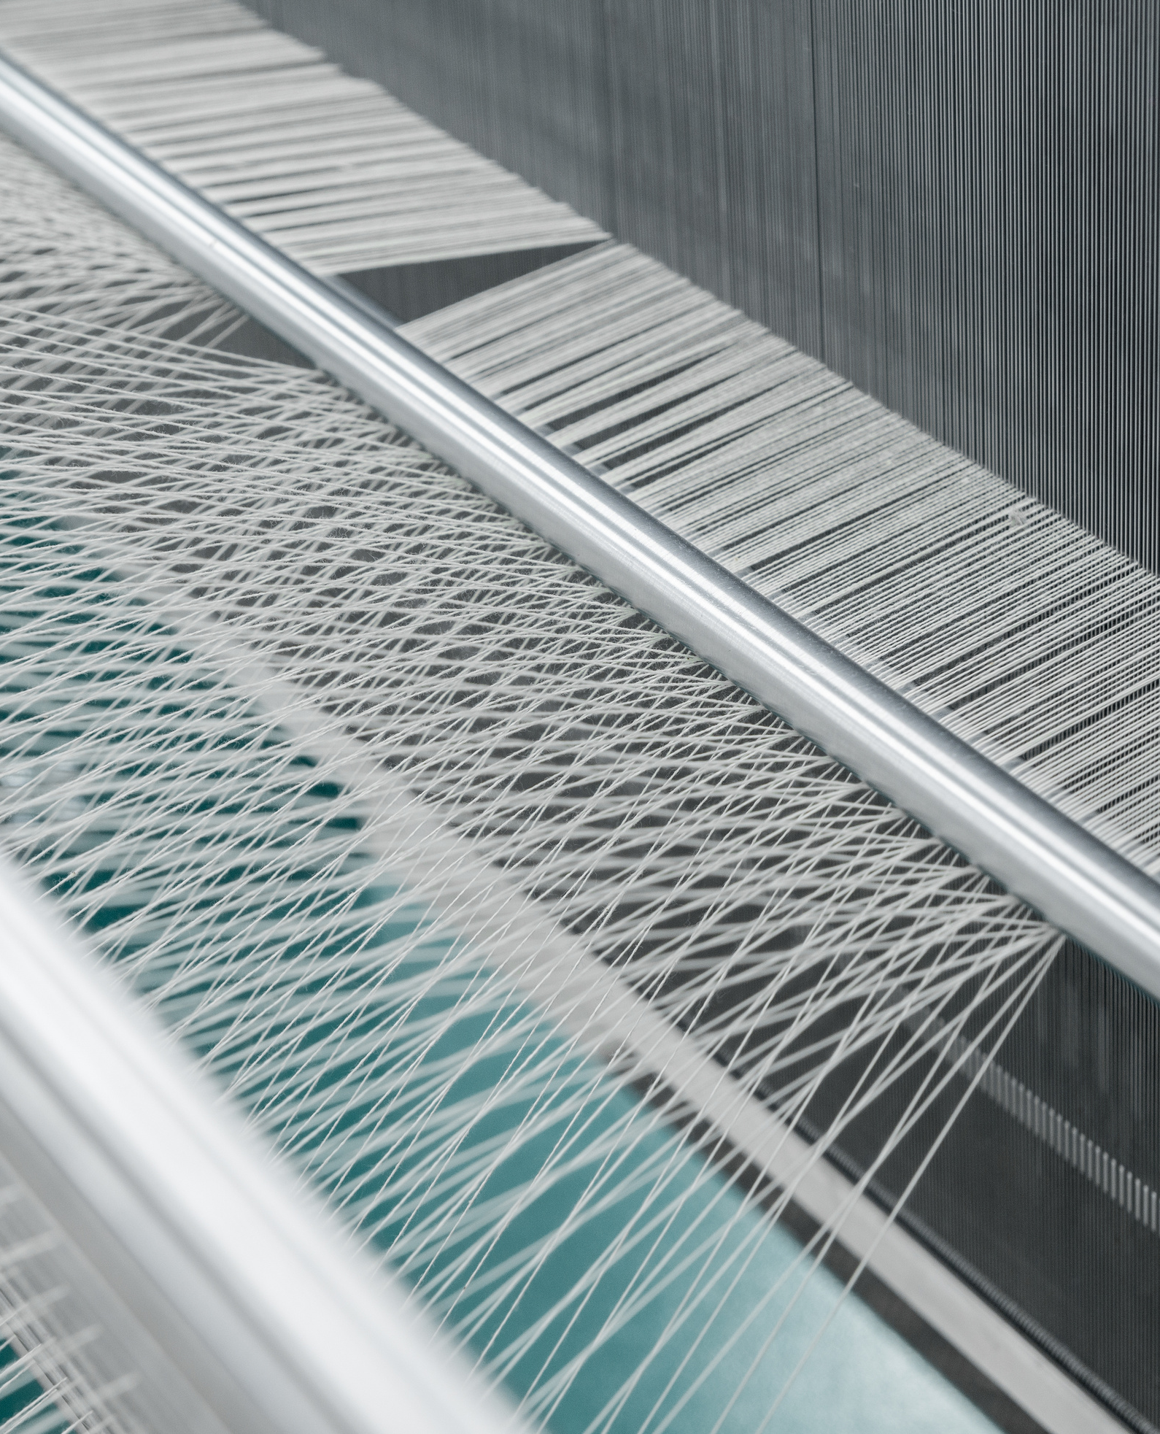
VISION
As a yarn and fabric manufacturer in the world of industrial textiles, to be the company that meets the expectations of its customers in the best way.

Slide 4
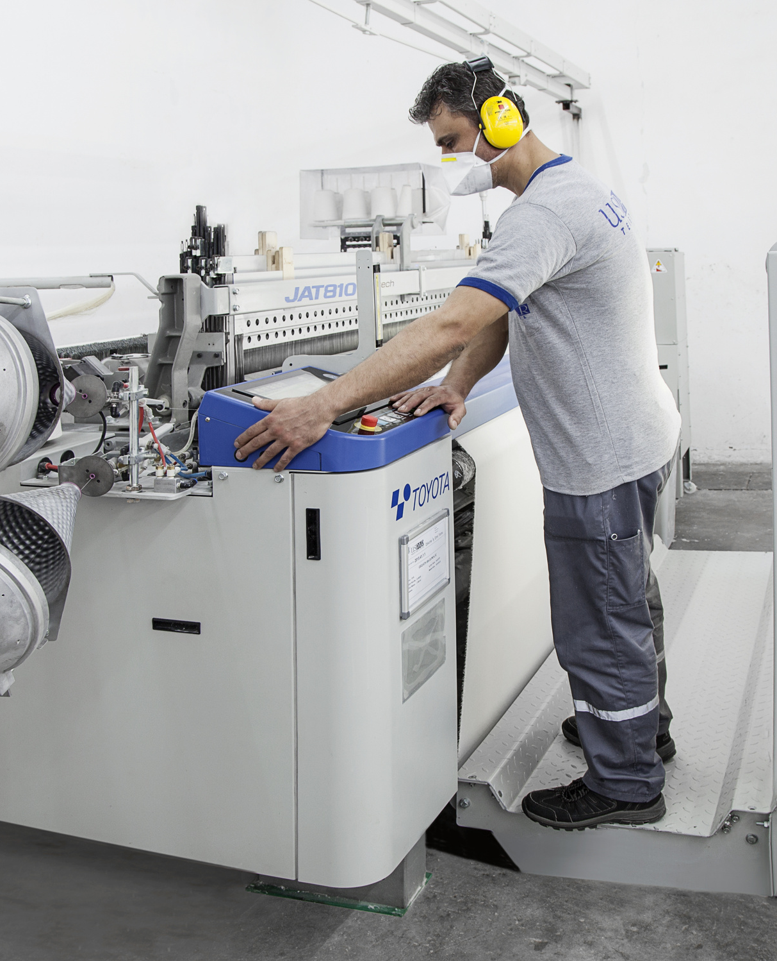
MISSION
Investing in machinery, equipment, software and human resources required to meet the customer expectations best.

Slide 5
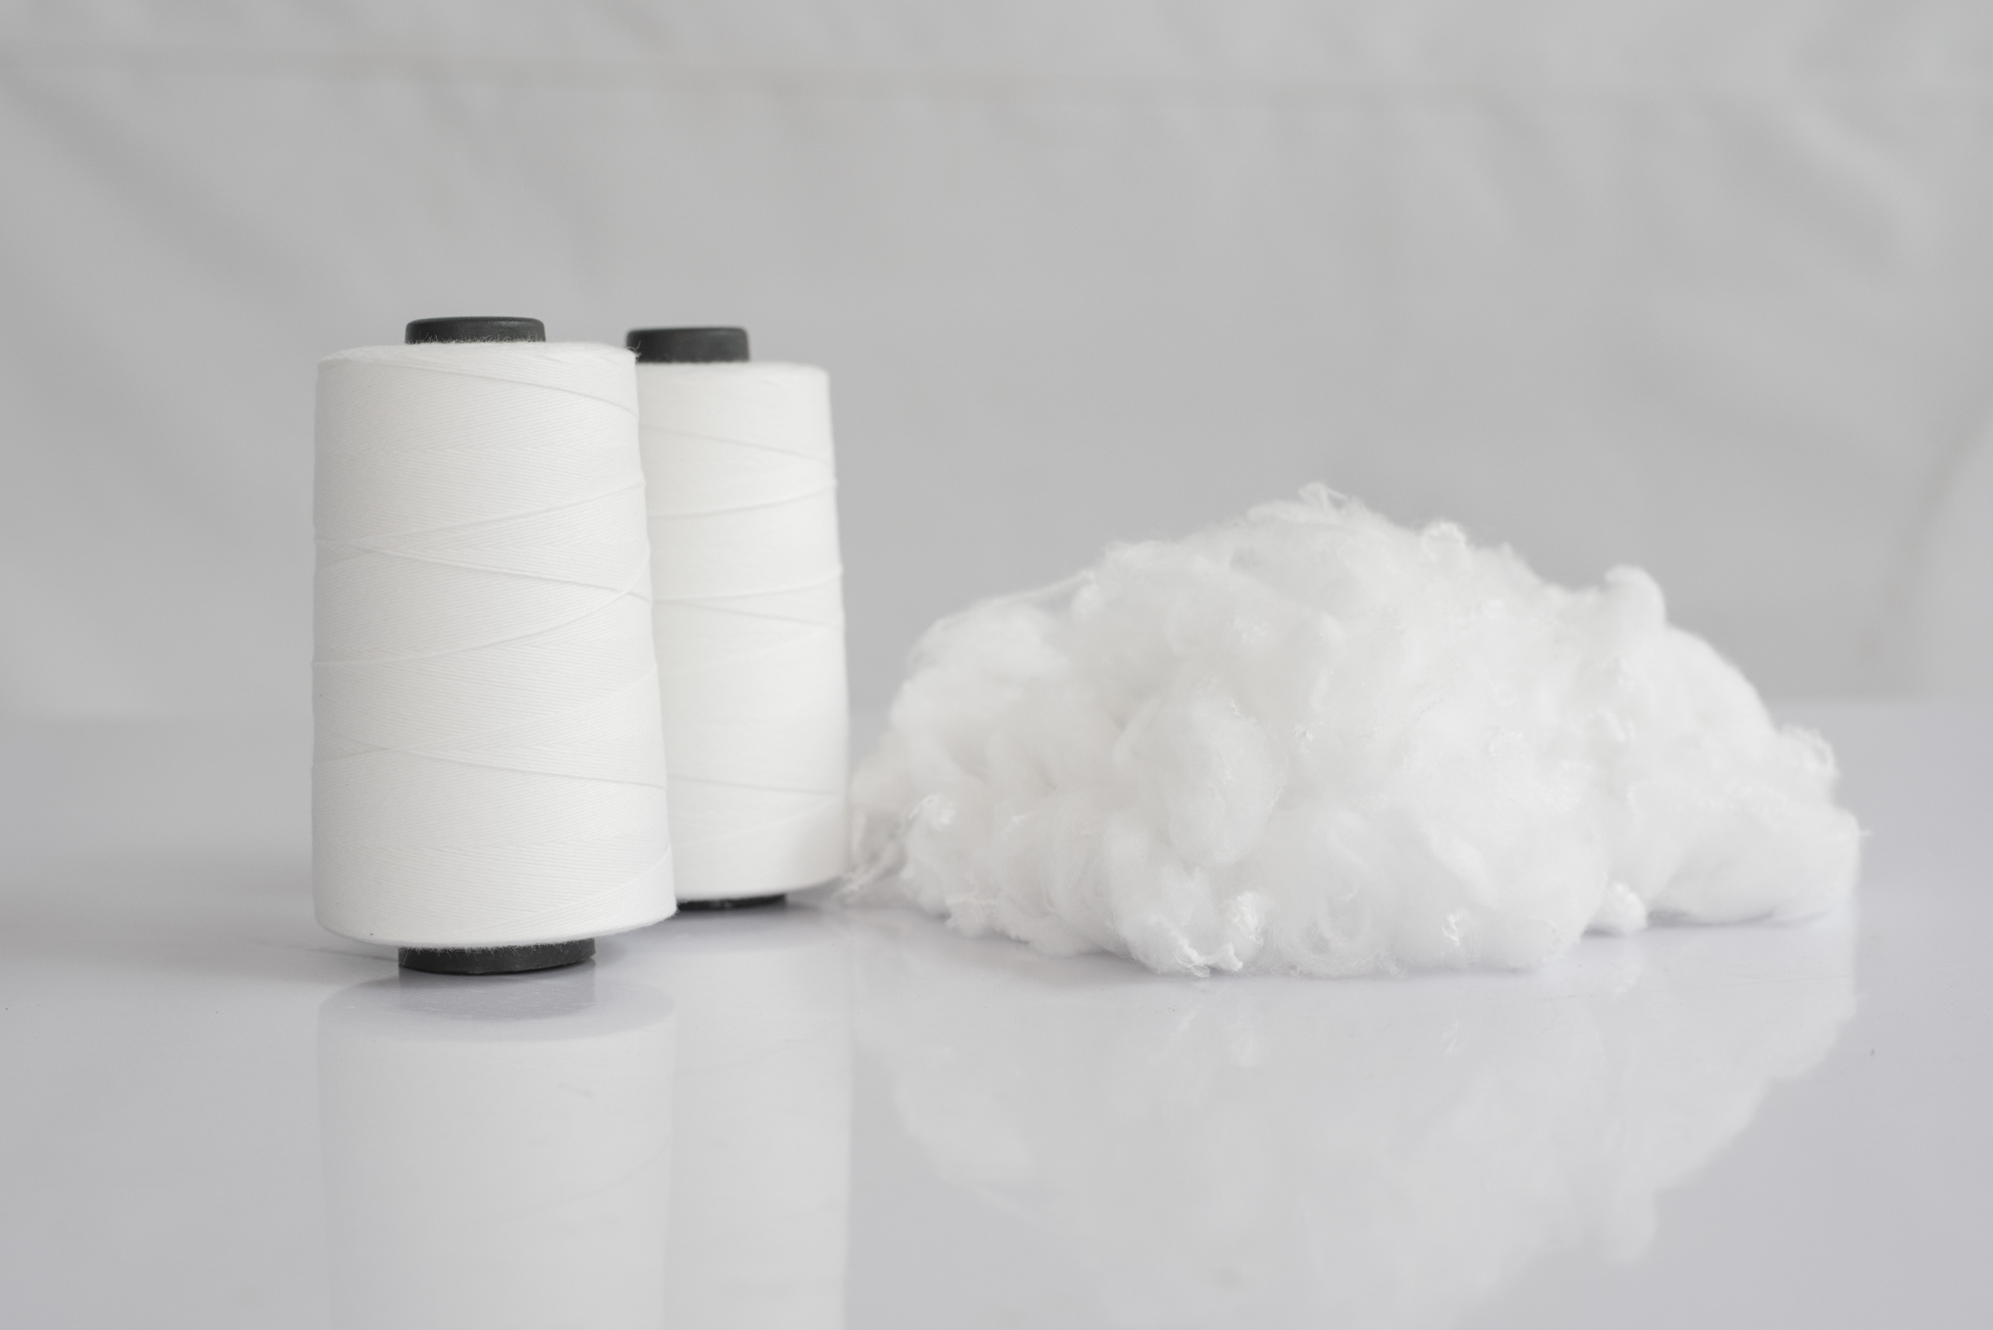



WHAT WE DO
WEAVING
SPINNING
In the width of 75 cm - 380 cm grey fabric production is being made in the weaving facility which aims to supply grey fabric needs of our customers .
Ne 6/1 to Ne 32/1 is manufactured for weaving and knitting by using selected USA origin Cotton and cotton /polyester blend in our Open-End facilities.

Slide 6
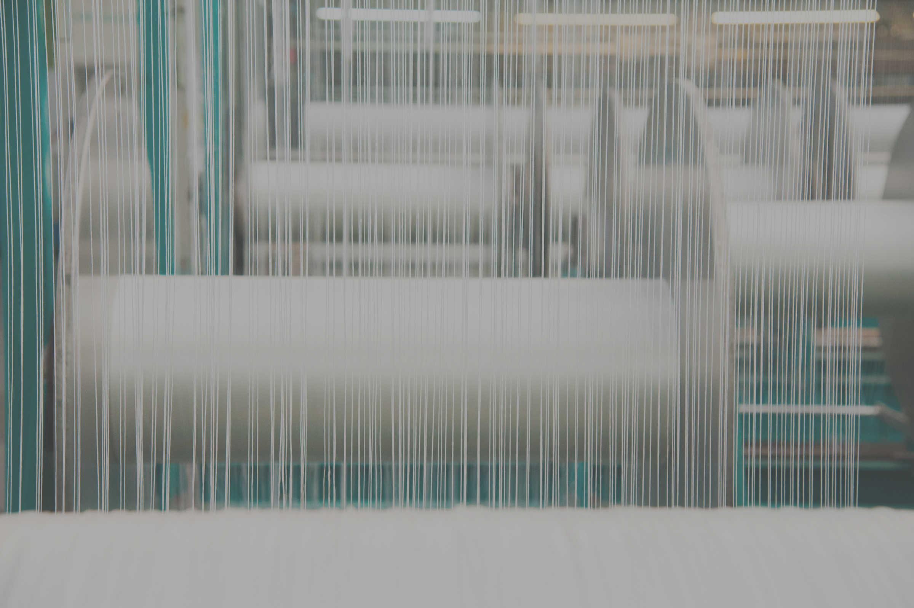



280
36 YEARS
9 MILLION
18,000 TONS
Employees
In business
meters of fabric production per annum
of yarn production
per annum

Slide 7
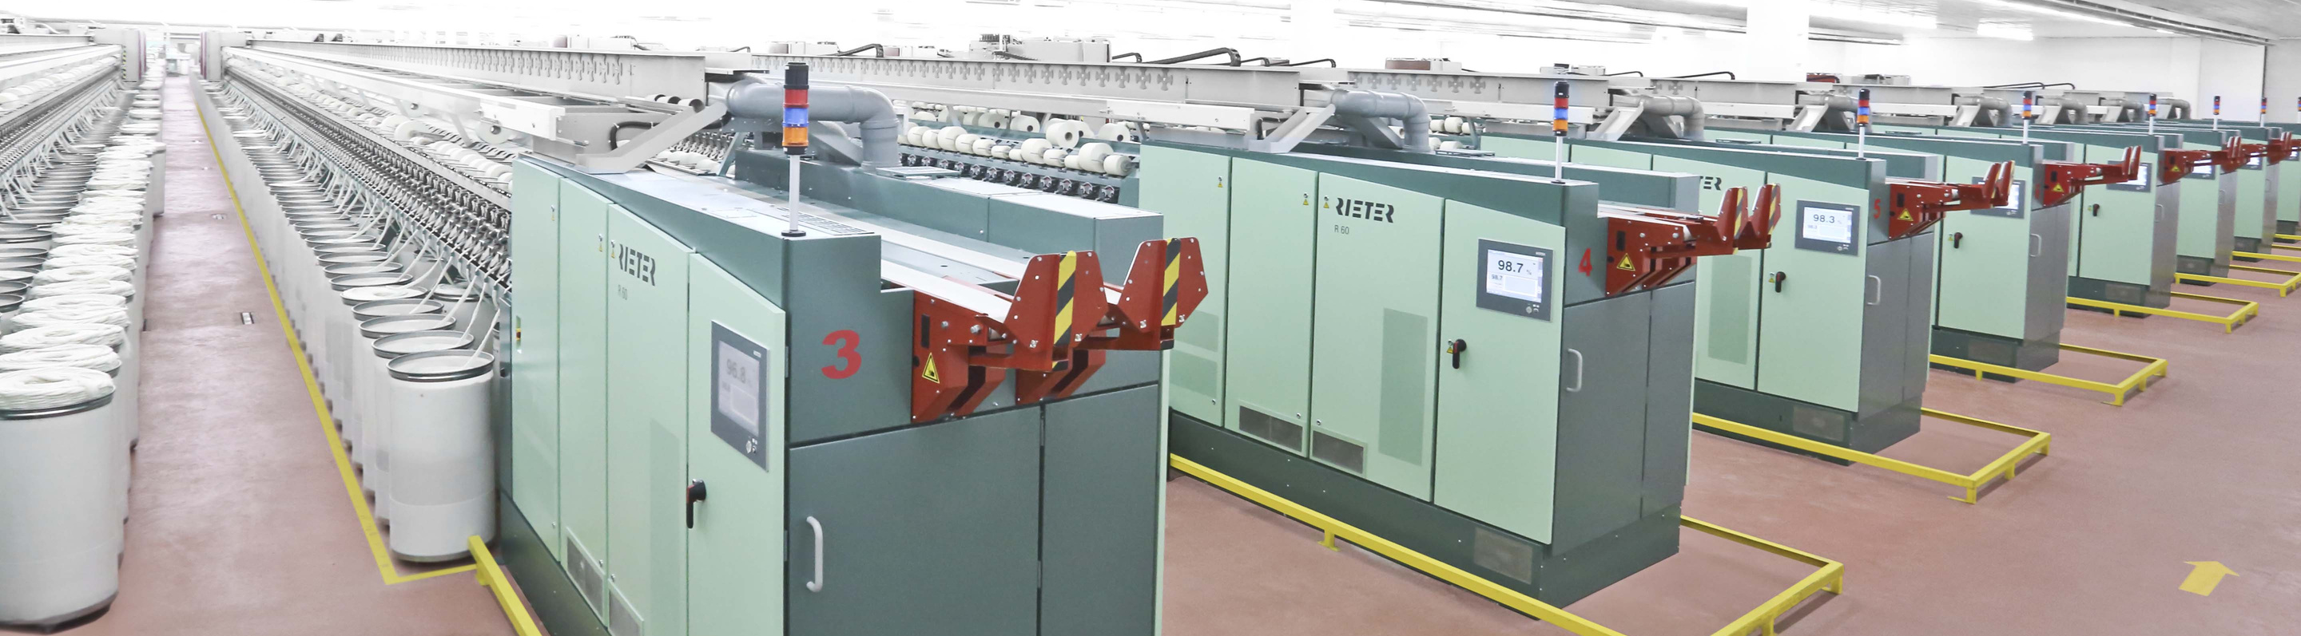
OPEN END PRODUCTION
Capacity : 70 tons / day
Rotor Quantity : 11.000 rotors
Production Line : Fiber and yarn preparation by Rieter - OE Spinning by Rieter ( 2007-2014)

Slide 8
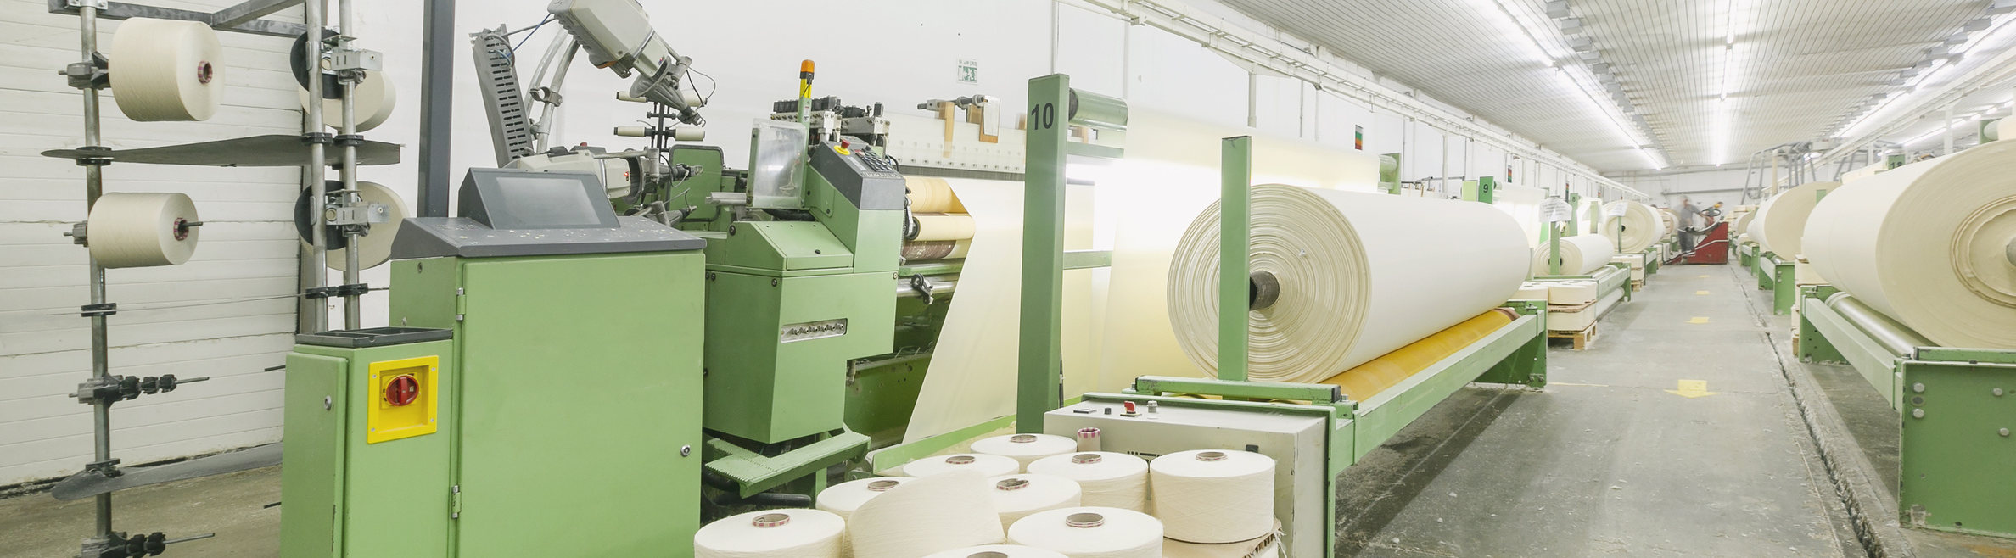
WEAVING PRODUCTION
Starting year : 2018
Capacity : 25-30.000 m / day
Weaving looms : 58 looms
Production Line : Air jet - Weaving by Toyota and Dornier

Slide 9
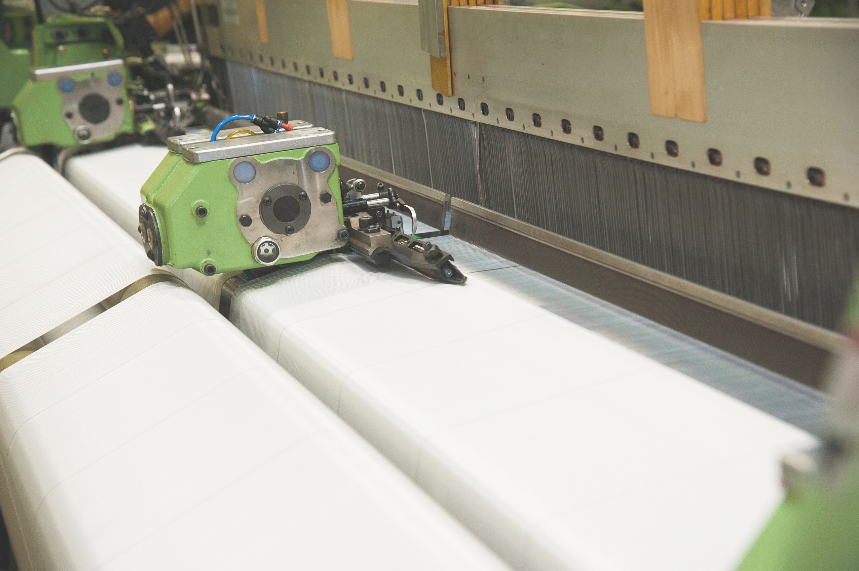

NON-STOP PRODUCTION

Slide 10
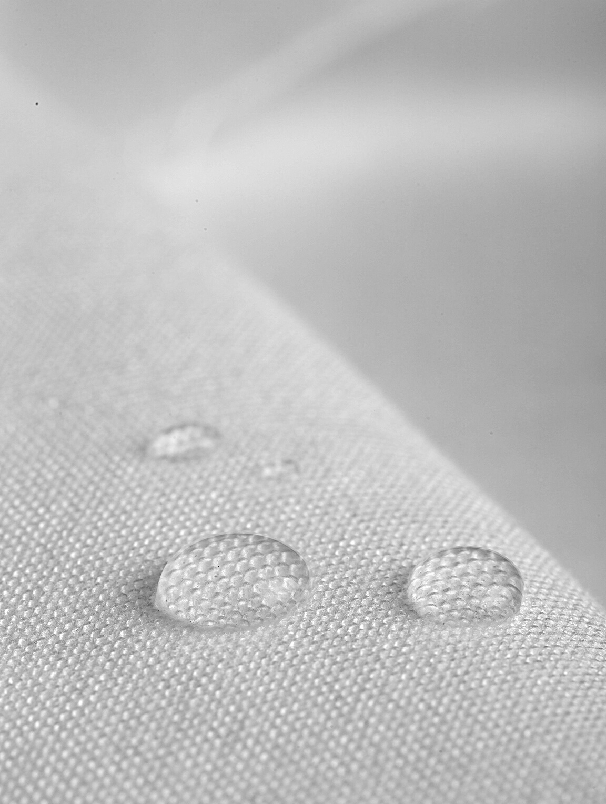
END-USE of USPAR PRODUCTS
Upholstery Fabrics
Tent-Sun Protection
Workwear
Protect Wear
Abrasive Cloth
Coated Textiles
Packtech
Home Textile
Medical

Slide 11
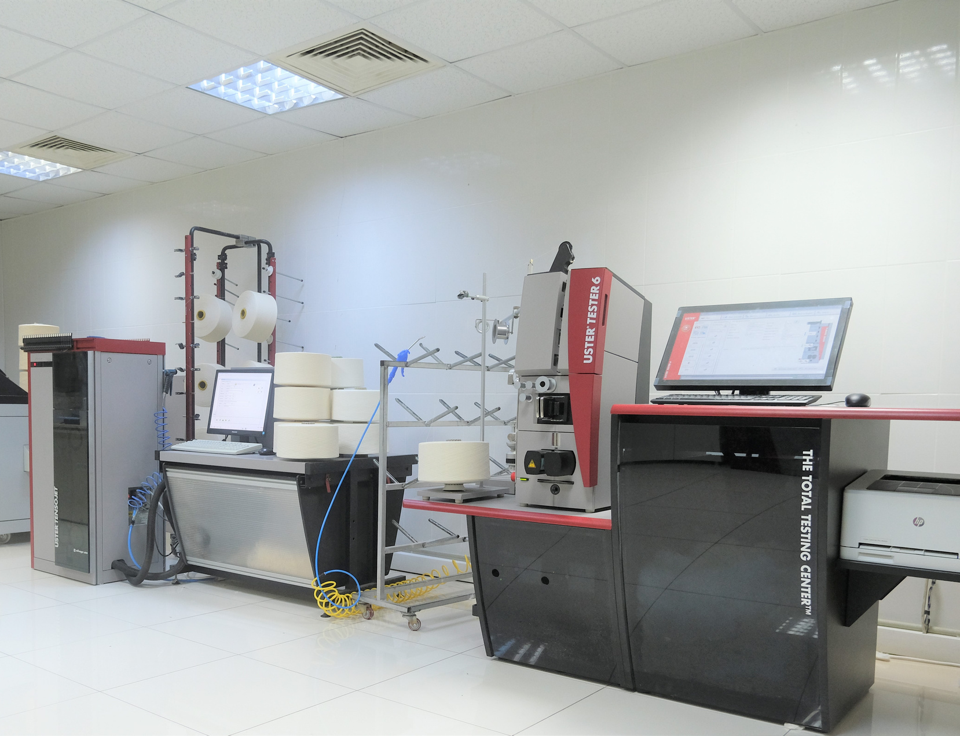
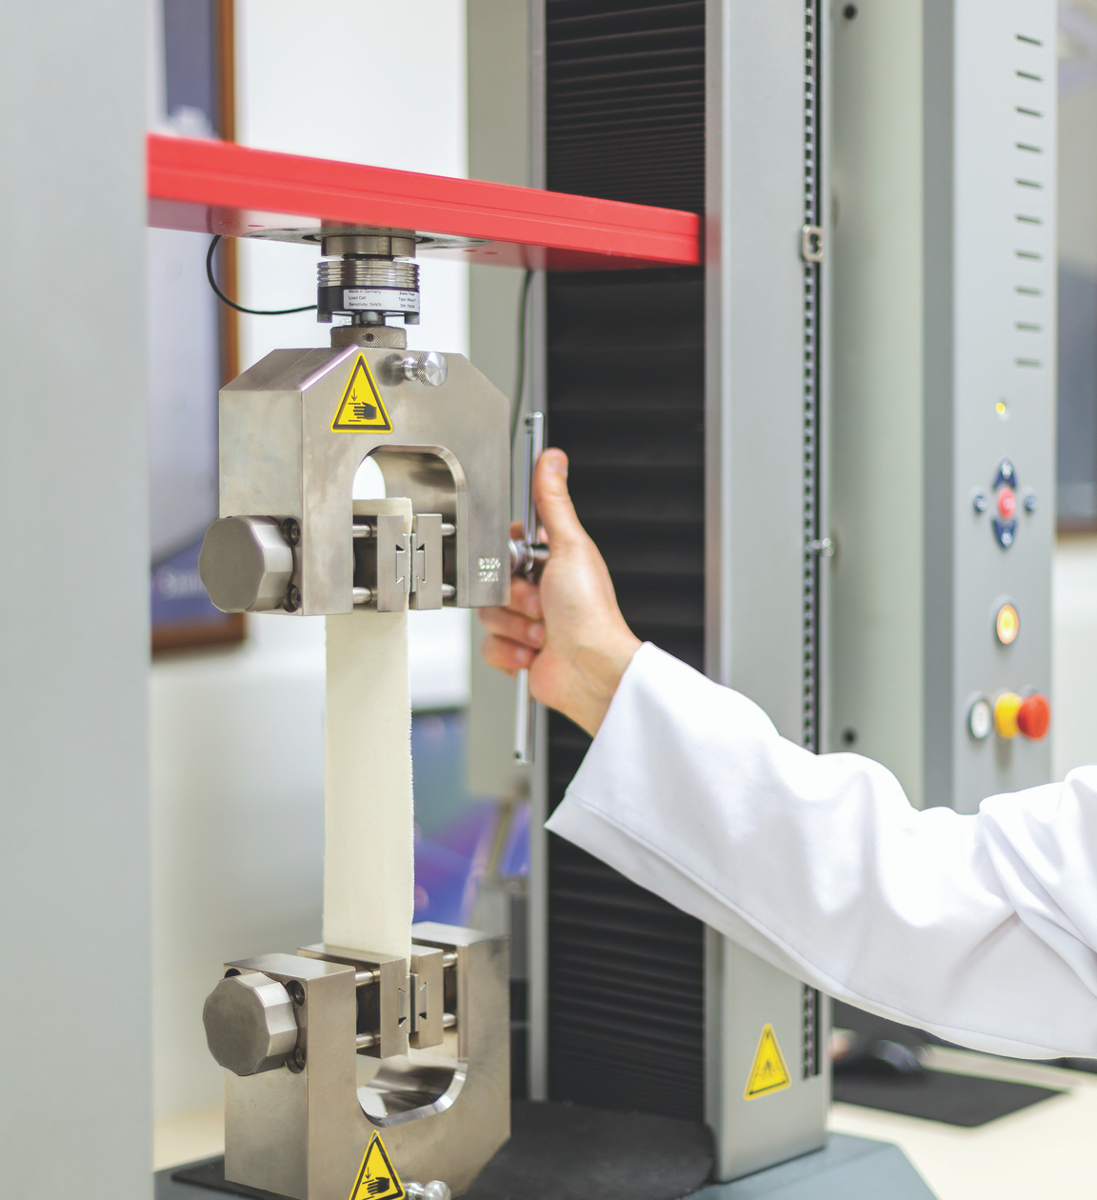
FABRIC LABORATORY
Memmert HPP 110-Condition Cabin
DIN EN 20139
Digital Fabric Thickness Gauge
Zwick Roell Z005
Prowhite Airpermeability Tester
FIBER AND YARN LABORATORY
High Volume Instrument (HVI)
Uster Tester 4 SE Conveyor-Sensor CS
Uster Tensojet
Uster Tenso Rapid 4
Uster MN100 Nep Tester

Slide 12
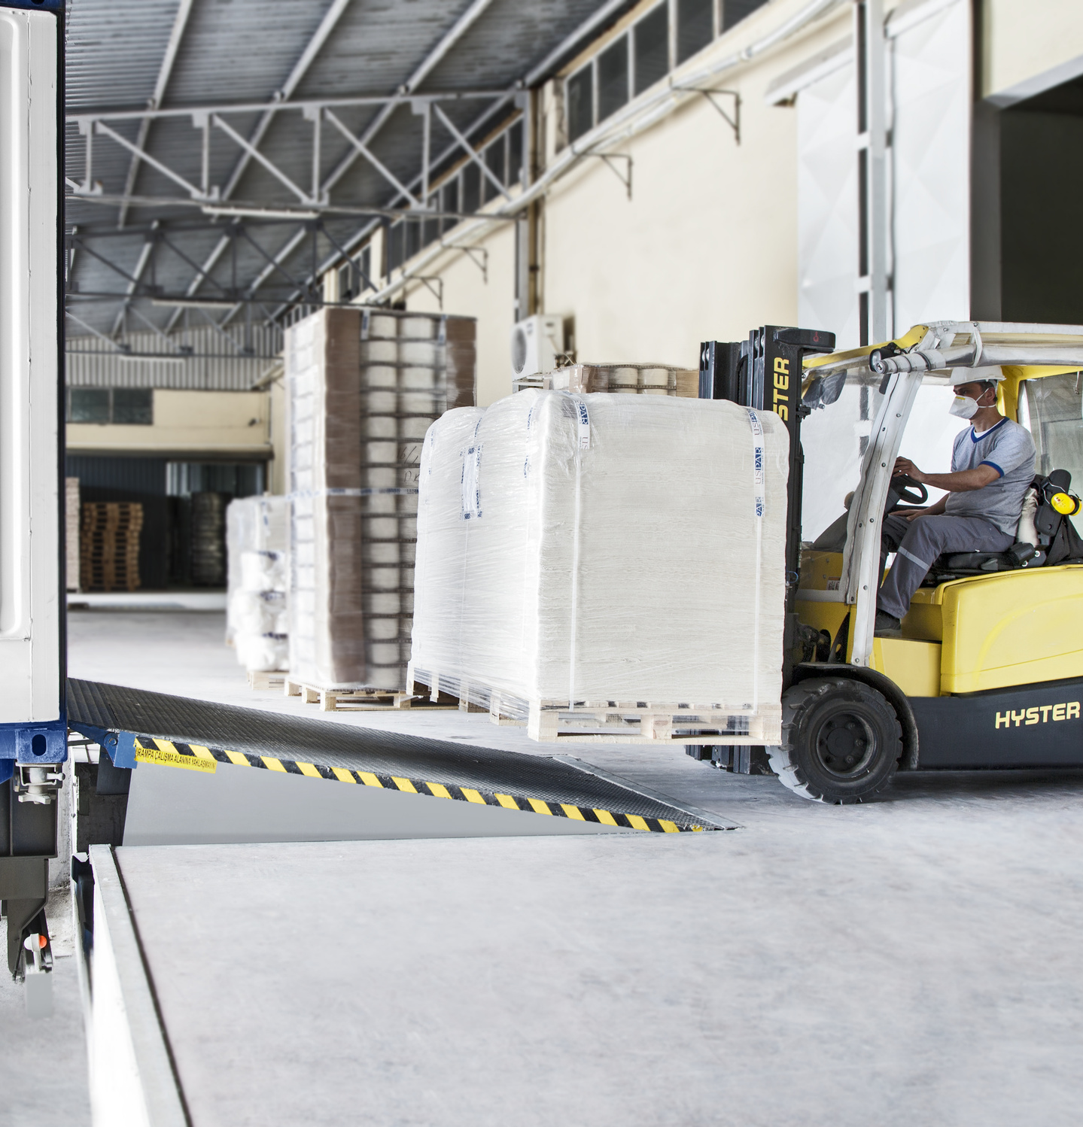
Concerning the customer demand, Uspar is capable of packing with the advantage of Folding System.

Slide 13
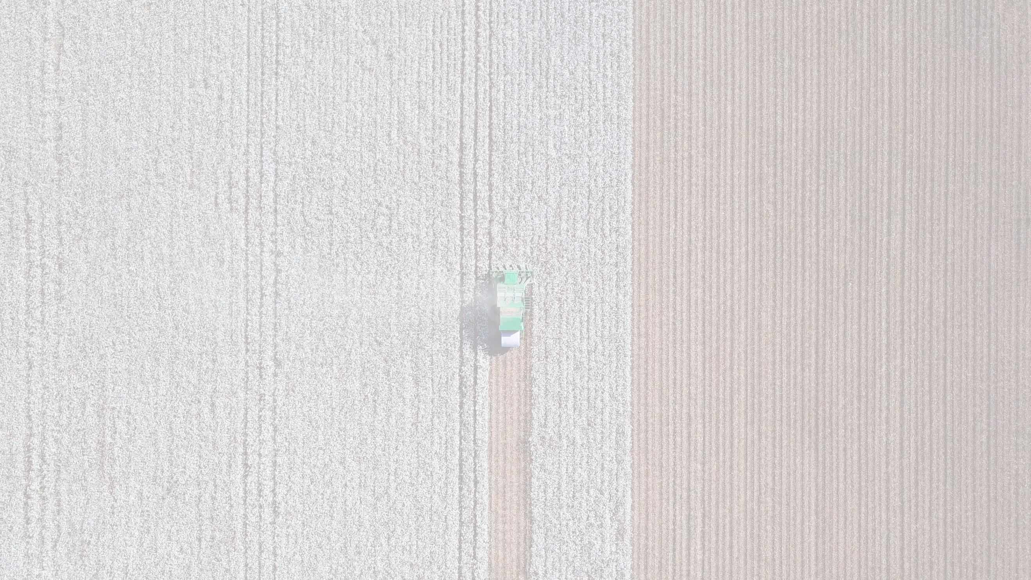
MILESTONES
Third Oe Mill start at Dazkırı with Rieter
Weaving Mill capacity expansion with Toyota looms
Second Oe Mill start with Autocoro Rotors
Polyester production line started
1986
1995
2008
2009
2014
2016
2017
2018
2019
First Oe Mill start Operation
Industrial Fabric Production starts with 6 Dornier Airjet looms Investment
Airjet looms production started with Dornier and Toyota
Oracle J.D Edwards ERP system has been implemented
ISO 9001 :2015 Quality Management has been implemented

Slide 14
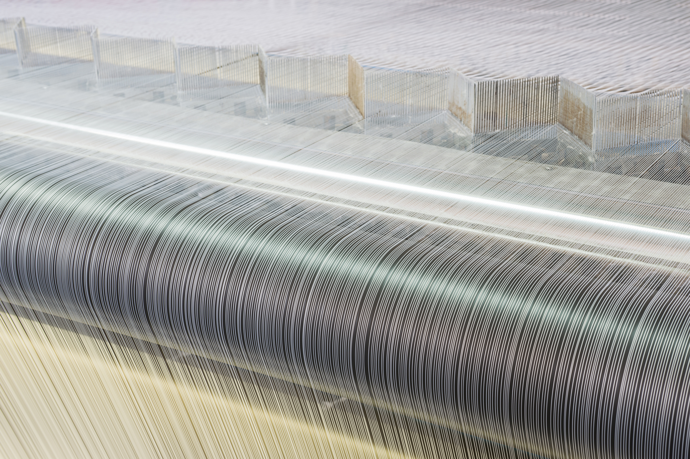
Thank you

Slide 15
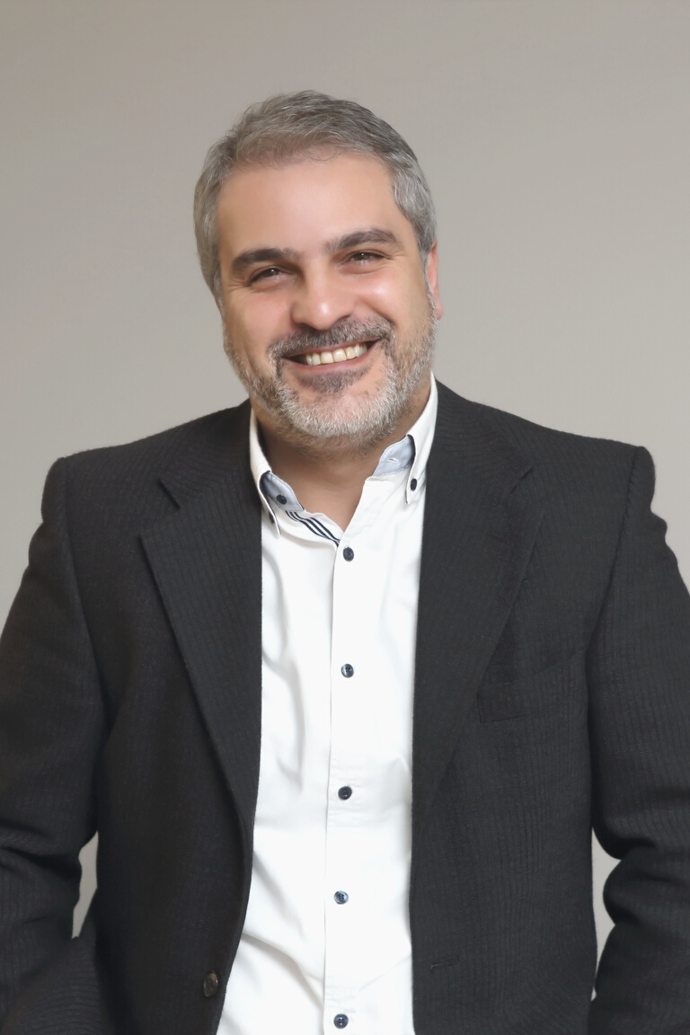
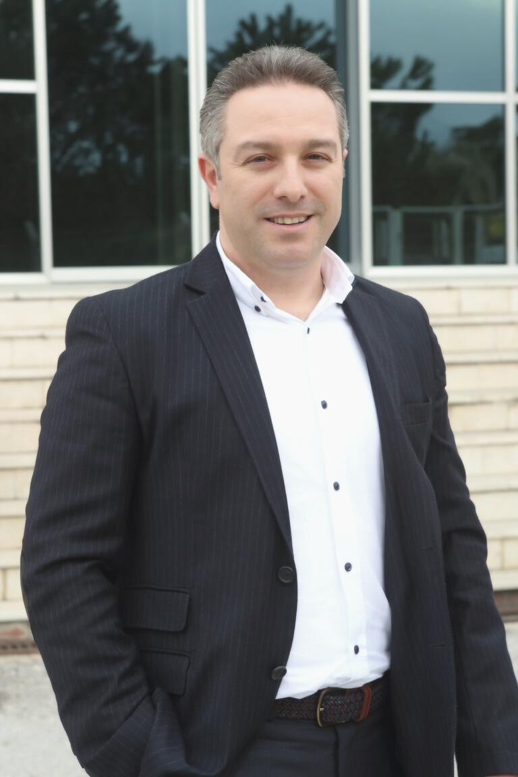
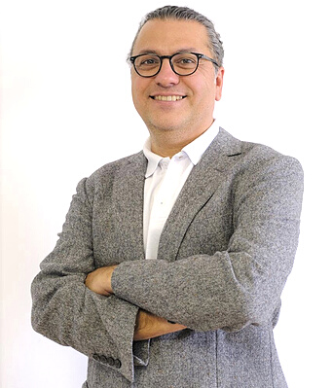
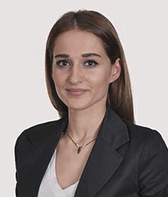
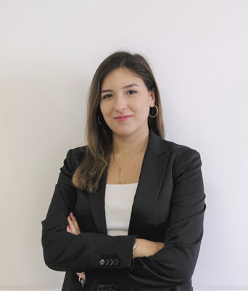
MEET THE TEAM
AHMET USLU
FEVZI USLU
SEÇKIN KAHVECILER
DICLE OCAK YÜCEL
GÜLCE YIKILMAZ
Chairman
General Director
Sales and Marketing Manager
Marketing Specialist
Marketing Assistant Specialist

Slide 16

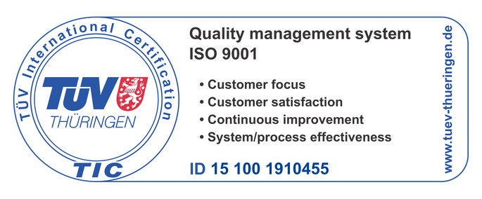







CONTACT
USPAR TEKSTIL SANAYI VE TICARET A.S.
Denizli OSB Nevzat Koru Cad. No:8 Honaz
20330 Denizli – TURKEY
www.uspar.com.tr
info@uspar.com.tr
P. + 90 258 269 10 04-05-06-07(PBX)
F. + 90 258 269 13 20

